Slide 1
PerfTest: Setup (RPT)
Yoonki Song
Last Updated: Sep. 16, 2009

Slide 2
Agent Controller
Installation and Configuration on the Server side

Slide 3
Repository
/usr/rptagent
Installation Directory
/opt/IBM/SDP/AgentController
Starting AC
# /opt/IBM/SDP/AgentController/bin/ACStart.sh

Slide 4
Rational Performance Tester v8.0
Installation and Configuration on the Client side

Slide 5
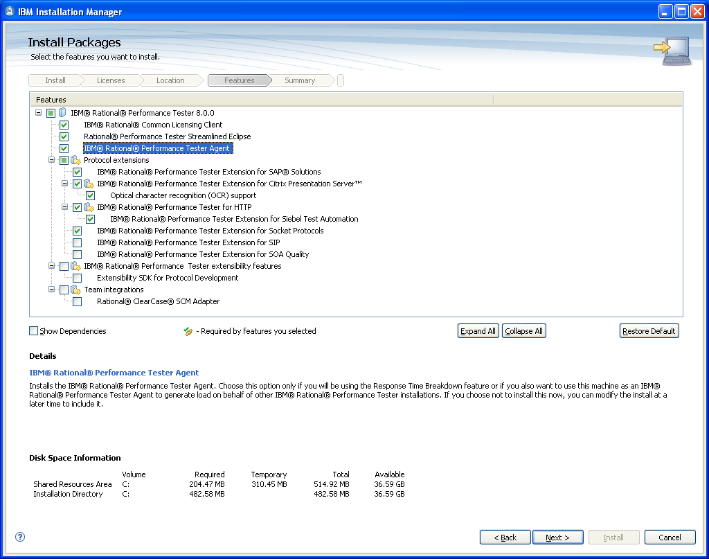
RPT Installation

Slide 6
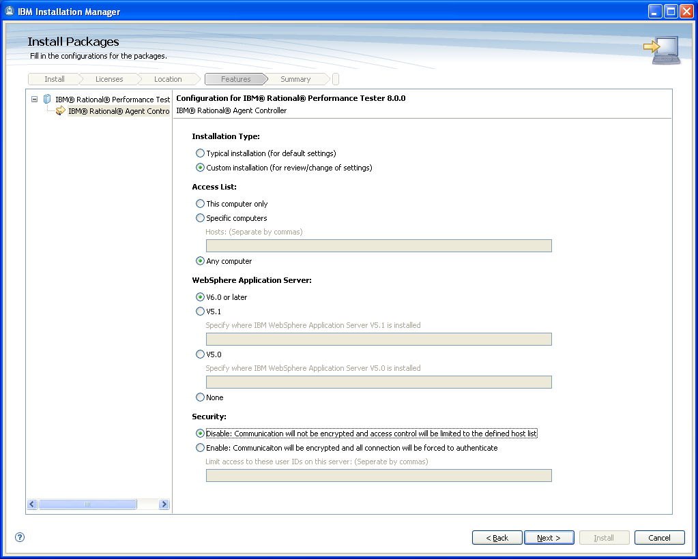
RPT Installation (Cont’d)

Slide 7
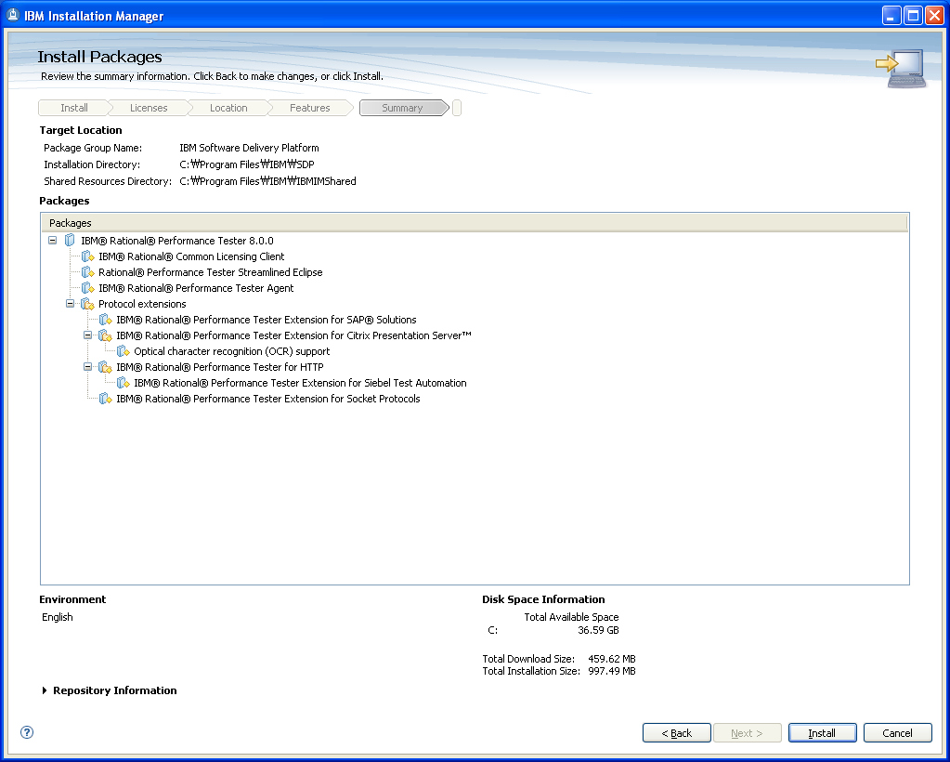
RPT Installation (Cont’d)

Slide 8
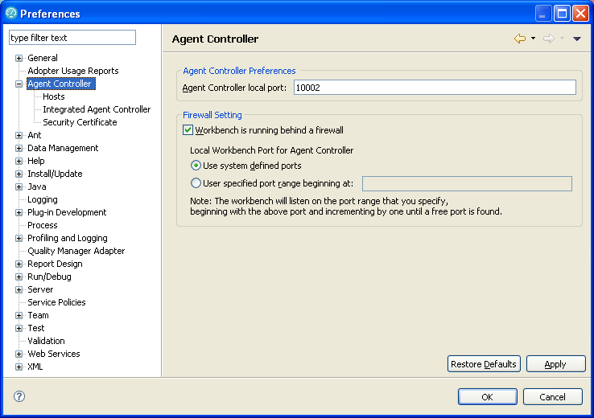
RPT Configuration

Slide 9
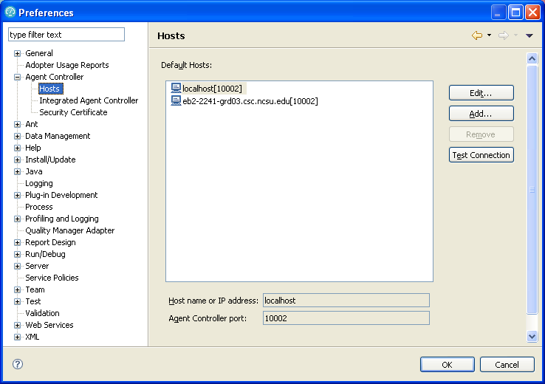
RPT Configuration (Cont’d)

Slide 10
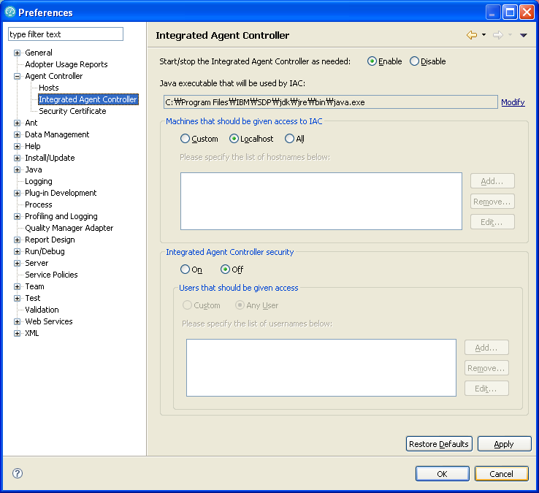
RPT Configuration (Cont’d)

Slide 11
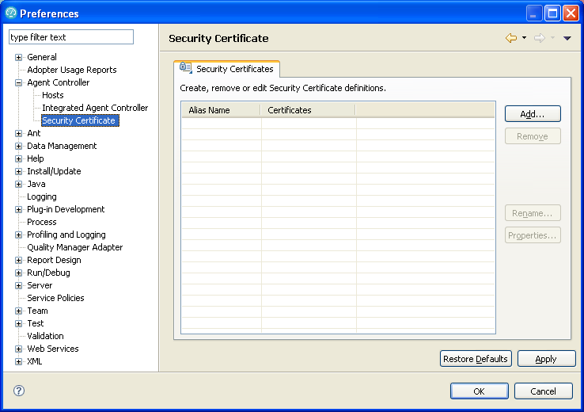
RPT Configuration (Cont’d)

Slide 12
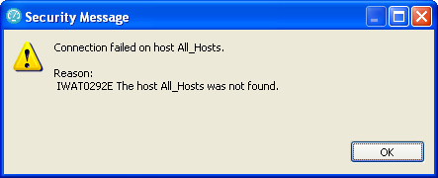
Trouble Shooting
IWAT0292E
http://www.ibm.com/developerworks/forums/message.jspa?messageID=13938063

